Slide 1
Murach’s SQL Server 2022
Chapter 6
How to code
subqueries

Slide 2
Objectives
Applied
Code SELECT statements that use subqueries with the IN and EXISTS operators and the ALL, ANY, and SOME keywords.
Code subqueries in the WHERE, HAVING, FROM, or SELECT clauses of a SELECT statement.
Code SELECT statements that use common table expressions (CTEs) to define the subqueries.
Knowledge
Describe the difference between a correlated subquery and a noncorrelated subquery.
Describe the use of common table expressions (CTEs).

Slide 3
Four ways to use a subquery in a SELECT statement
In a WHERE clause as a search condition
In a HAVING clause as a search condition
In the FROM clause as a table specification
In the SELECT clause as a column specification

Slide 4
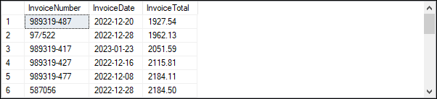
A subquery in the WHERE clause
SELECT InvoiceNumber, InvoiceDate, InvoiceTotal
FROM Invoices
WHERE InvoiceTotal >
(SELECT AVG(InvoiceTotal)
FROM Invoices)
ORDER BY InvoiceTotal;
The value returned by the subquery
1879.7413
The result set (21 rows)

Slide 5
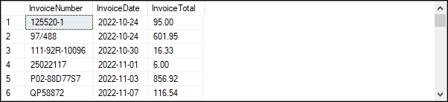
A query that uses an inner join
SELECT InvoiceNumber, InvoiceDate, InvoiceTotal
FROM Invoices i
JOIN Vendors v
ON i.VendorID = v.VendorID
WHERE VendorState = 'CA'
ORDER BY InvoiceDate;
The result set (40 rows)

Slide 6
The same query restated with a subquery
SELECT InvoiceNumber, InvoiceDate, InvoiceTotal
FROM Invoices
WHERE VendorID IN
(SELECT VendorID
FROM Vendors
WHERE VendorState = 'CA')
ORDER BY InvoiceDate;
The same result set (40 rows)

Slide 7
The syntax of a WHERE clause that uses an IN phrase with a subquery
WHERE test_expression [NOT] IN (subquery)

Slide 8
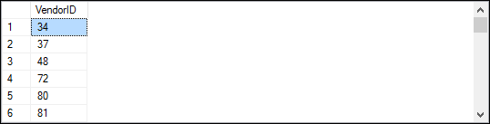
A query that returns vendors without invoices
SELECT VendorID, VendorName, VendorState
FROM Vendors
WHERE VendorID NOT IN
(SELECT DISTINCT VendorID
FROM Invoices);
The result of the subquery (34 rows)

Slide 9
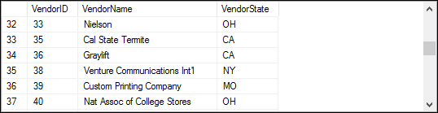
The result set of the query that uses an IN phrase (88 rows)

Slide 10
The query restated without a subquery
SELECT v.VendorID, VendorName, VendorState
FROM Vendors v
LEFT JOIN Invoices i
ON v.VendorID = i.VendorID
WHERE i.VendorID IS NULL;
The same result set (88 rows)

Slide 11
The syntax of a WHERE clause that uses a comparison operator
WHERE expression comparison_operator [SOME|ANY|ALL]
(subquery)

Slide 12
A query with a subquery in the WHERE condition
SELECT InvoiceNumber, InvoiceDate, InvoiceTotal,
InvoiceTotal - PaymentTotal - CreditTotal AS BalanceDue
FROM Invoices
WHERE InvoiceTotal - PaymentTotal - CreditTotal > 0
AND InvoiceTotal - PaymentTotal - CreditTotal <
(SELECT AVG(InvoiceTotal - PaymentTotal - CreditTotal)
FROM Invoices
WHERE InvoiceTotal - PaymentTotal - CreditTotal > 0)
ORDER BY InvoiceTotal DESC;
The value returned by the subquery
2910.9472

Slide 13
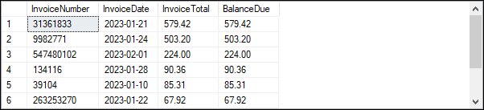
The result set of the query with a subquery in the WHERE condition (9 rows)

Slide 14
How the ALL keyword works
x > ALL (1, 2) (equivalent to x > 2)
x < ALL (1, 2) (equivalent to x < 1)
x = ALL (1, 2) (equivalent to (x = 1) AND (x = 2))
x <> ALL (1, 2) (equivalent to (x <> 1) AND (x <> 2))

Slide 15

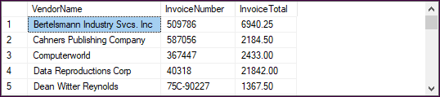
A query that uses the ALL keyword
SELECT VendorName, InvoiceNumber, InvoiceTotal
FROM Invoices i JOIN Vendors v
ON i.VendorID = v.VendorID
WHERE InvoiceTotal > ALL
(SELECT InvoiceTotal FROM Invoices WHERE VendorID = 34)
ORDER BY VendorName;
The result of the subquery
The result set (25 rows)

Slide 16
How the ANY and SOME keywords work
x > ANY (1, 2) (equivalent to x > 1)
x < ANY (1, 2) (equivalent to x < 2)
x = ANY (1, 2) (equivalent to (x = 1) OR (x = 2))
x <> ANY (1, 2) (equivalent to (x <> 1) OR (x <> 2))

Slide 17
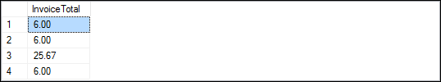
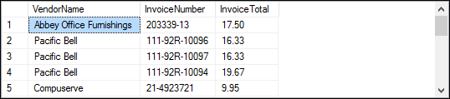
A query that uses the ANY keyword
SELECT VendorName, InvoiceNumber, InvoiceTotal
FROM Vendors v
JOIN Invoices i
ON v.VendorID = i.VendorID
WHERE InvoiceTotal < ANY
(SELECT InvoiceTotal FROM Invoices WHERE VendorID = 115);
The result of the subquery
The result set (17 rows)

Slide 18
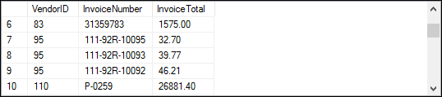
A query that uses a correlated subquery
SELECT VendorID, InvoiceNumber, InvoiceTotal
FROM Invoices i
WHERE InvoiceTotal >
(SELECT AVG(InvoiceTotal) FROM Invoices AS i_sub
WHERE i_sub.VendorID = i.VendorID)
ORDER BY VendorID, InvoiceTotal;
The value returned by the subquery for vendor 95
28.5016
The result set (36 rows)

Slide 19
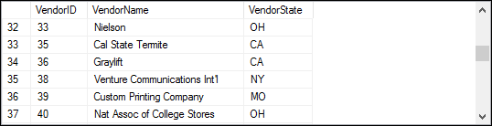
The syntax of a subquery EXISTS
WHERE [NOT] EXISTS (subquery)
A query that returns vendors without invoices
SELECT VendorID, VendorName, VendorState
FROM Vendors v
WHERE NOT EXISTS
(SELECT *
FROM Invoices i
WHERE i.VendorID = v.VendorID);
The result set (88 rows)

Slide 20
A subquery coded in the FROM clause
SELECT i.VendorID, MAX(InvoiceDate) AS LatestInv,
AVG(InvoiceTotal) AS AvgInvoice
FROM Invoices i
JOIN
(SELECT TOP 5 VendorID, AVG(InvoiceTotal)
AS AvgInvoice
FROM Invoices
GROUP BY VendorID
ORDER BY AvgInvoice DESC) tv -- tv -> TopVendor
ON i.VendorID = tv.VendorID
GROUP BY i.VendorID
ORDER BY LatestInv DESC;

Slide 21
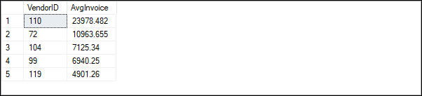
The derived table generated by the subquery

Slide 22
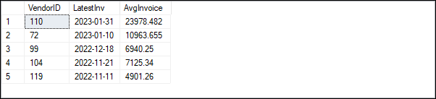
The result set that uses the derived table

Slide 23
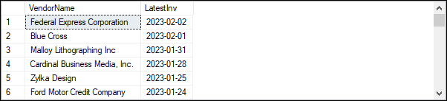
A correlated subquery in the SELECT clause
SELECT DISTINCT VendorName,
(SELECT MAX(InvoiceDate) FROM Invoices i
WHERE i.VendorID = v.VendorID) AS LatestInv
FROM Vendors v
ORDER BY LatestInv DESC;
The result set (122 rows)

Slide 24
The same query restated using a join
SELECT VendorName, MAX(InvoiceDate) AS LatestInv
FROM Vendors v
LEFT JOIN Invoices i
ON v.VendorID = i.VendorID
GROUP BY VendorName
ORDER BY LatestInv DESC;
The same result set (122 rows)

Slide 25
A complex query with three subqueries
SELECT Summary1.VendorState, Summary1.VendorName,
TopInState.SumOfInvoices
FROM
(SELECT v.VendorState, v.VendorName,
SUM(i.InvoiceTotal) AS SumOfInvoices
FROM Invoices AS i
JOIN Vendors AS v ON i.VendorID = v.VendorID
GROUP BY v.VendorState, v.VendorName) AS Summary1
JOIN
(SELECT Summary2.VendorState,
MAX(Summary2.SumOfInvoices) AS SumOfInvoices
FROM
(SELECT v.VendorState, v.VendorName,
SUM(i.InvoiceTotal) AS SumOfInvoices
FROM Invoices AS i
JOIN Vendors AS v ON i.VendorID = v.VendorID
GROUP BY v.VendorState, v.VendorName) AS Summary2
GROUP BY Summary2.VendorState) AS TopInState
ON Summary1.VendorState = TopInState.VendorState AND
Summary1.SumOfInvoices = TopInState.SumOfInvoices
ORDER BY Summary1.VendorState;

Slide 26
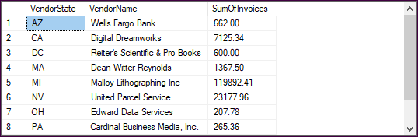
The result set of the complex query (10 rows)

Slide 27
Pseudocode for the query
SELECT Summary1.VendorState, Summary1.VendorName,
TopInState.SumOfInvoices
FROM (Derived table returning VendorState, VendorName,
SumOfInvoices)
AS Summary1
JOIN (Derived table returning VendorState,
MAX(SumOfInvoices))
AS TopInState
ON Summary1.VendorState = TopInState.VendorState AND
Summary1.SumOfInvoices = TopInState.SumOfInvoices
ORDER BY s1.VendorState;

Slide 28
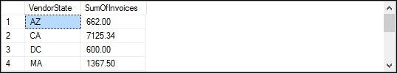
Pseudocode for the TopInState subquery
SELECT Summary2.VendorState, MAX(Summary2.SumOfInvoices)
FROM (Derived table returning VendorState, VendorName,
SumOfInvoices)
AS Summary2
GROUP BY Summary2.VendorState;
The result of the TopInState subquery (10 rows)

Slide 29
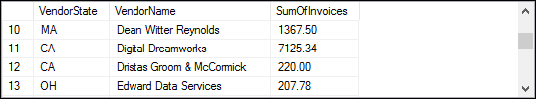
Code for the Summary1 and Summary2 subqueries
SELECT v.VendorState, v.VendorName,
SUM(i.InvoiceTotal) AS SumOfInvoices
FROM Invoices AS i JOIN Vendors AS v
ON i.VendorID = v.VendorID
GROUP BY v.VendorState, v.VendorName;
The result of the subqueries

Slide 30
The syntax of a CTE
WITH cte_name1 AS (query_definition1)
[, cte_name2 AS (query_definition2)]
[...]
sql_statement

Slide 31
Two CTEs and a query that uses them
WITH Summary AS
(
SELECT VendorState, VendorName,
SUM(InvoiceTotal) AS SumOfInvoices
FROM Invoices i JOIN Vendors v
ON i.VendorID = v.VendorID
GROUP BY VendorState, VendorName
),
TopInState AS
(
SELECT VendorState,
MAX(SumOfInvoices) AS SumOfInvoices
FROM Summary
GROUP BY VendorState
)
SELECT s.VendorState, s.VendorName, t.SumOfInvoices
FROM Summary s JOIN TopInState t
ON s.VendorState = t.VendorState AND
s.SumOfInvoices = t.SumOfInvoices
ORDER BY s.VendorState;

Slide 32

The result set of the query that uses CTEs (10 rows)

Slide 33
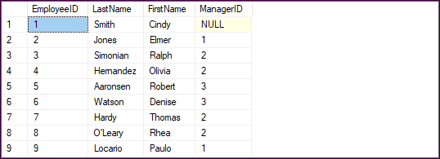
The Employees table

Slide 34
A recursive CTE that returns hierarchical data
WITH EmployeesCTE AS
(
-- Anchor member
SELECT EmployeeID,
FirstName + ' ' + LastName AS EmployeeName,
1 As Rank
FROM Employees
WHERE ManagerID IS NULL
UNION ALL
-- Recursive member
SELECT e.EmployeeID,
FirstName + ' ' + LastName,
Rank + 1
FROM Employees e
JOIN EmployeesCTE e2
ON e.ManagerID = e2.EmployeeID
)
SELECT *
FROM EmployeesCTE
ORDER BY Rank, EmployeeID;

Slide 35
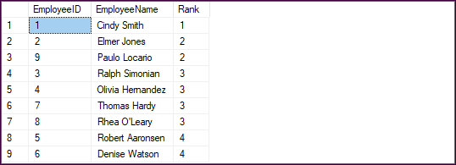
The result set for the recursive CTE

